Slide 1
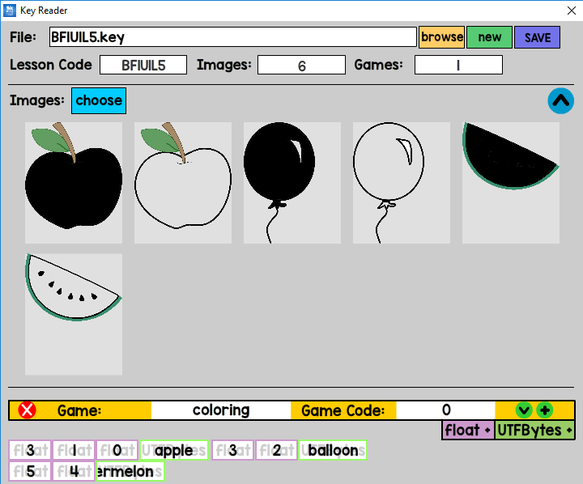
Filename (non-input)
Number of games (non-input)
Lesson code(input)
Number of images (non-input)
Images (for all games)
Game banner
Click to add floats or UTFBytes (numbers or strings)
Click the variable to add a value
Hold Ctrl and drag to rearrange variables
Right click to delete variable
1
7
BF1U1L1
0
6
0
1
KEY File Header
Lesson Code
Num of images
Num of games
Image data
1
103
C:\Users\1\Documents\GitHub\keyword-games\Keyword Games and Activities\bin\img\apple color_1@4x (2).png
1
79
C:\Users\1\Documents\GitHub\keyword-games\Keyword Games and Activities\bin\img\apple color_1@4x.png
1
103
C:\Users\1\Documents\GitHub\keyword-games\Keyword Games and Activities\bin\img\balloon color@4x (2).png
1
99
C:\Users\1\Documents\GitHub\keyword-games\Keyword Games and Activities\bin\img\balloon color@4x.png
1
108
C:\Users\1\Documents\GitHub\keyword-games\Keyword Games and Activities\bin\img\watermelon color_1@4x (2).png
1
104
C:\Users\1\Documents\GitHub\keyword-games\Keyword Games and Activities\bin\img\watermelon color_1@4x.png
url
game name
game code
number of variables
1
8
coloring
0
0
0
10
Game Header
0
3
← Number of images
0
1
0
0
1
5
apple
Game data
0
3
0
2
1
7
balloon
0
5
0
4
1
10
watermelon
Img ref
mask ref
word
Game data
1
?
???
0
?
0
?
Game Header
…

